Slide 1
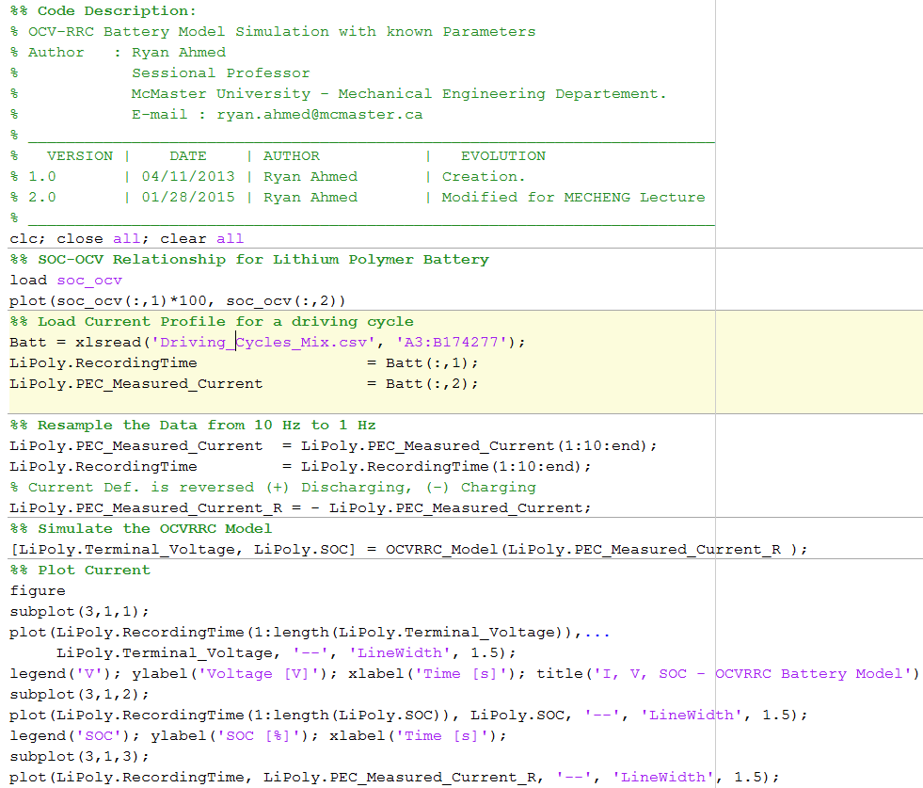
EQUIVALENT CIRCUIT BATTERY MODEL: OCV-RRC MATLAB EXAMPLE - MODEL SIMULATION
Plot SOC-OCV Relationship
Load current profile for a driving cycle mix
Simulate the OCV-RRC Model

Slide 2
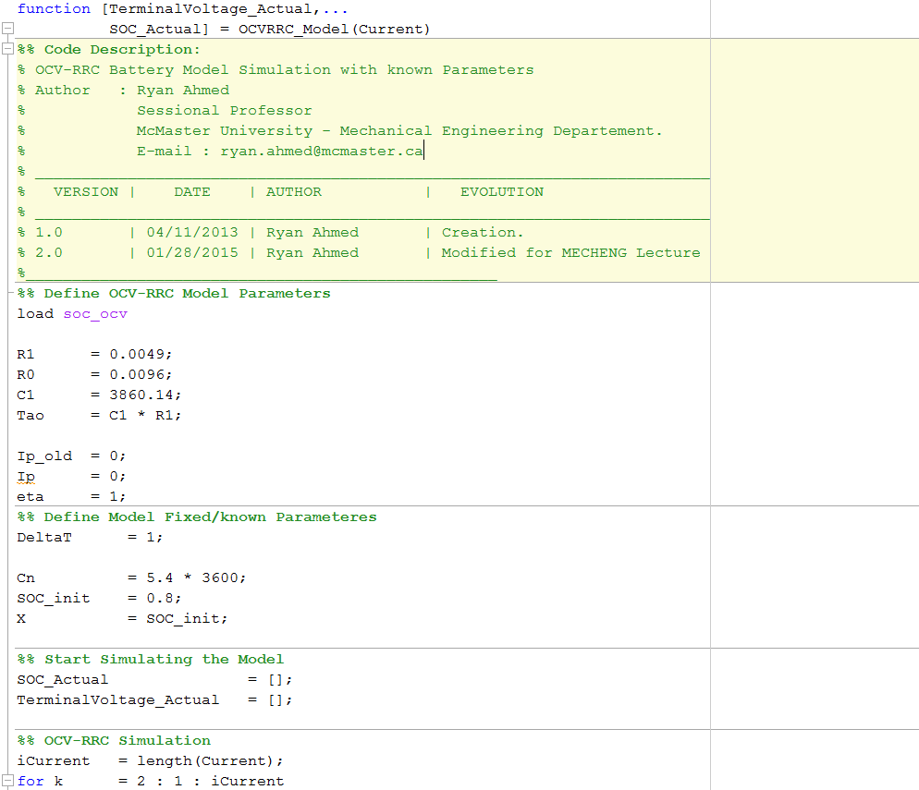
EQUIVALENT CIRCUIT BATTERY MODEL: OCV-RRC MATLAB EXAMPLE - MODEL SIMULATION
Define Model Parameters
Define SOC, VT accumulators

Slide 3
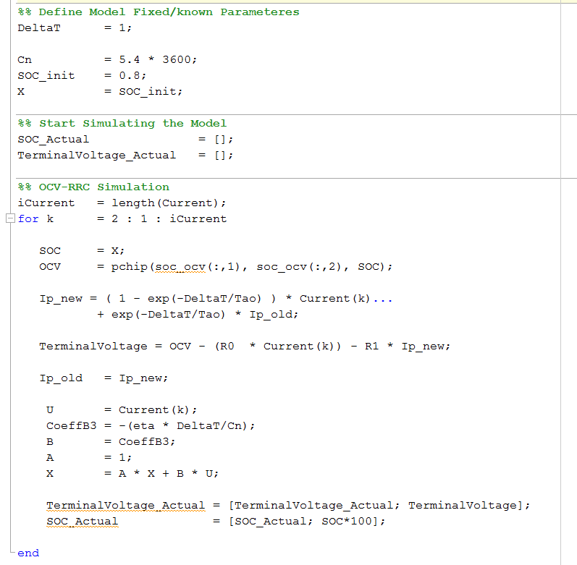
EQUIVALENT CIRCUIT BATTERY MODEL: OCV-RRC MATLAB EXAMPLE - MODEL SIMULATION
OCV-RRC Model
SOC Update – Coulomb Counting

Slide 4
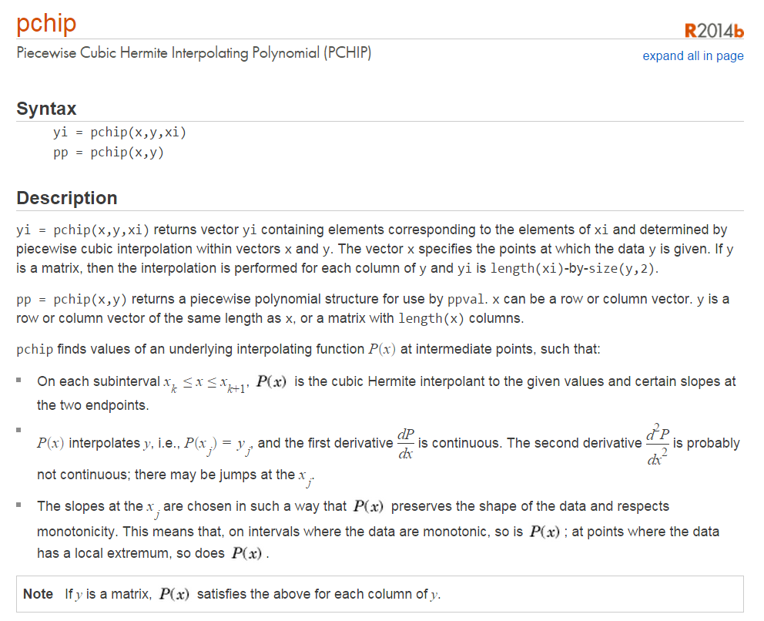
EQUIVALENT CIRCUIT BATTERY MODEL: OCV-RRC MATLAB EXAMPLE - PCHIP
http://www.mathworks.com/help/matlab/ref/pchip.html

